Slide 1
AratsNa ONLINE BUS BOOKING SYSTEM
IT – FREPM 15370(10:30 – 12:00 PM TTH)

Slide 2
INTRODUCTION
The AratsNa Online Bus Booking System is a web and mobile-based platform for transportation booking. This system will help people who don’t own any kind of vehicle to go out of town with their family or loved ones. The purpose of this project is to inform and help users to book a bus with ease with the use of our program. It comes along with different packages in order to be cost efficient for the user. This system can be used by the users in performing online booking via the internet for their all-business purposes. In addition, allow the user to choose what type of bus they want and our system will provide services.

Slide 3
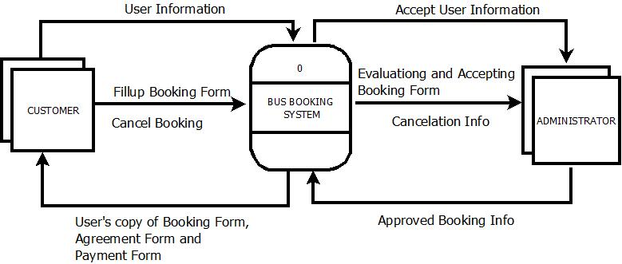
DATA FLOW DIAGRAMS

Slide 4
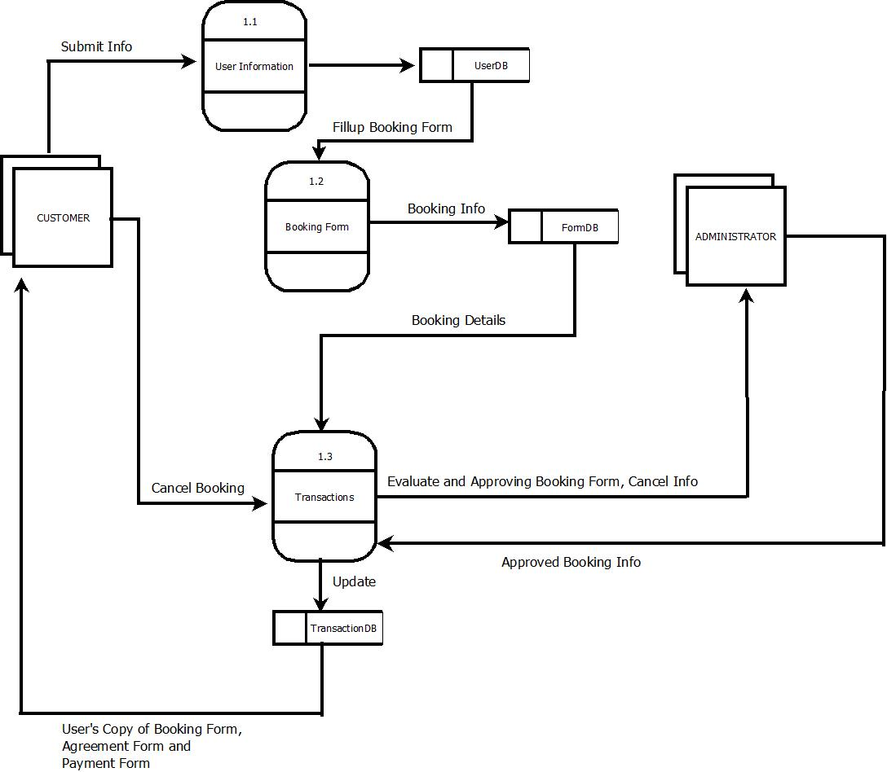

Slide 5
PROJECT OBJECTIVES
To help users to book a bus with ease.
To provide a transportation service.
To reduce manual work of booking.
To allow user to place their booking at a time that is most convenient for them.
To develop a booking system in an efficient and effective manner.
To capture more potential business because reservations and information are always available.

Slide 6
SCOPE AND LIMITATIONS OF THE PROJECT
The scope of this project is developing web and mobile-based platform transportation booking. The functions which cover this project are focusing on making online bus booking and online reservations. Users and the administrator will be able to use the system effectively. Users can perform online booking via the internet. This system is an automated system for reservation or booking buses online by using the web and mobile-based system. In addition, allow the user to choose what type of bus they want, and our system will provide services. This project contains a reservation system for customers to reserve a bus online and a booking system for the organization to control the rental process and manage bus rental online easily.

Slide 7
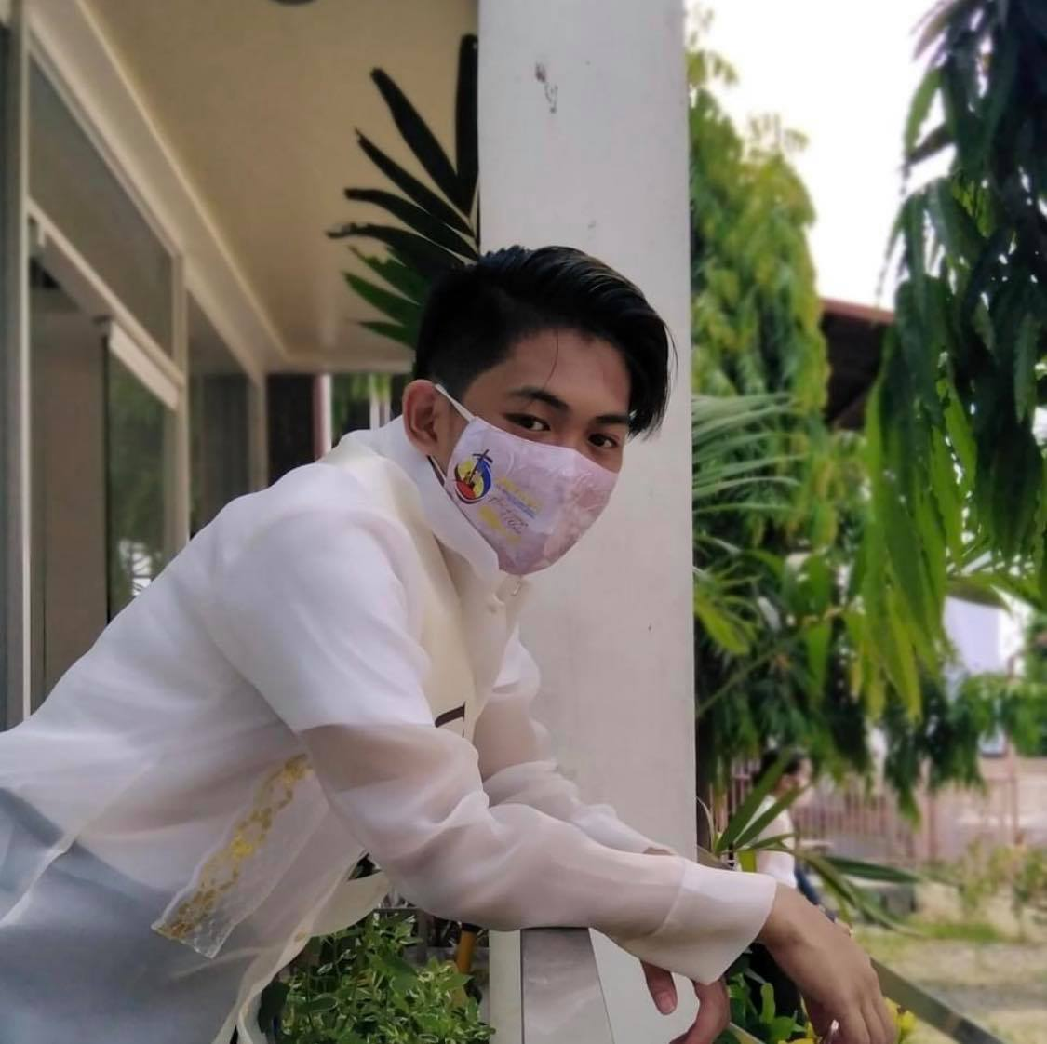

Group members:
Capili, Kurt Laurence
Inoc, Ares Ann

Slide 8
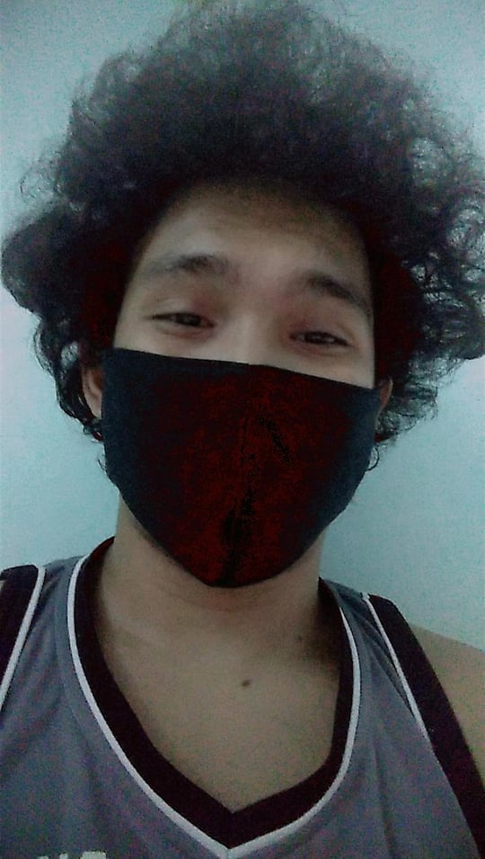
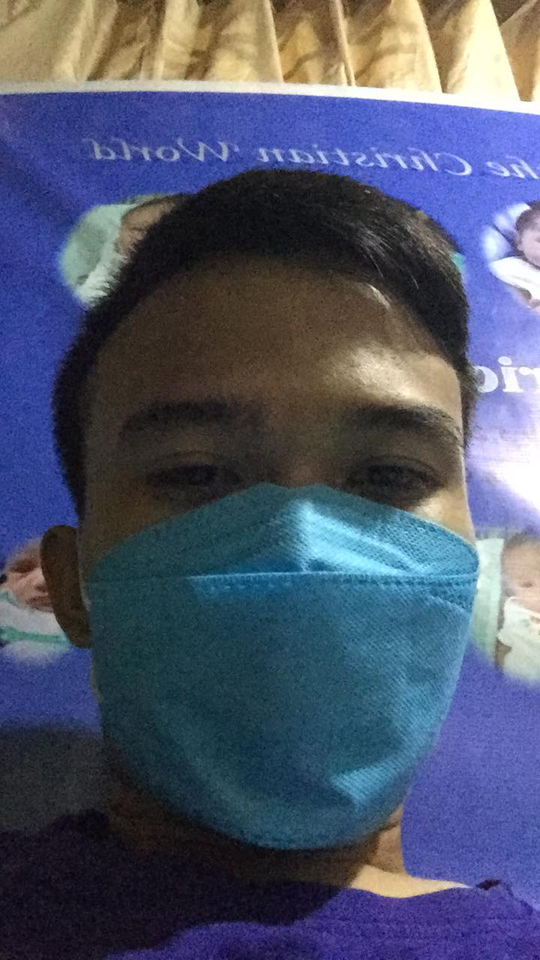
Manlangit, Klient Lourence
Paradero, Jesse

Slide 9
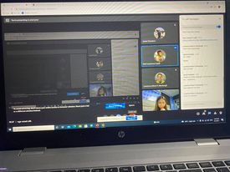
How we do it

Slide 10
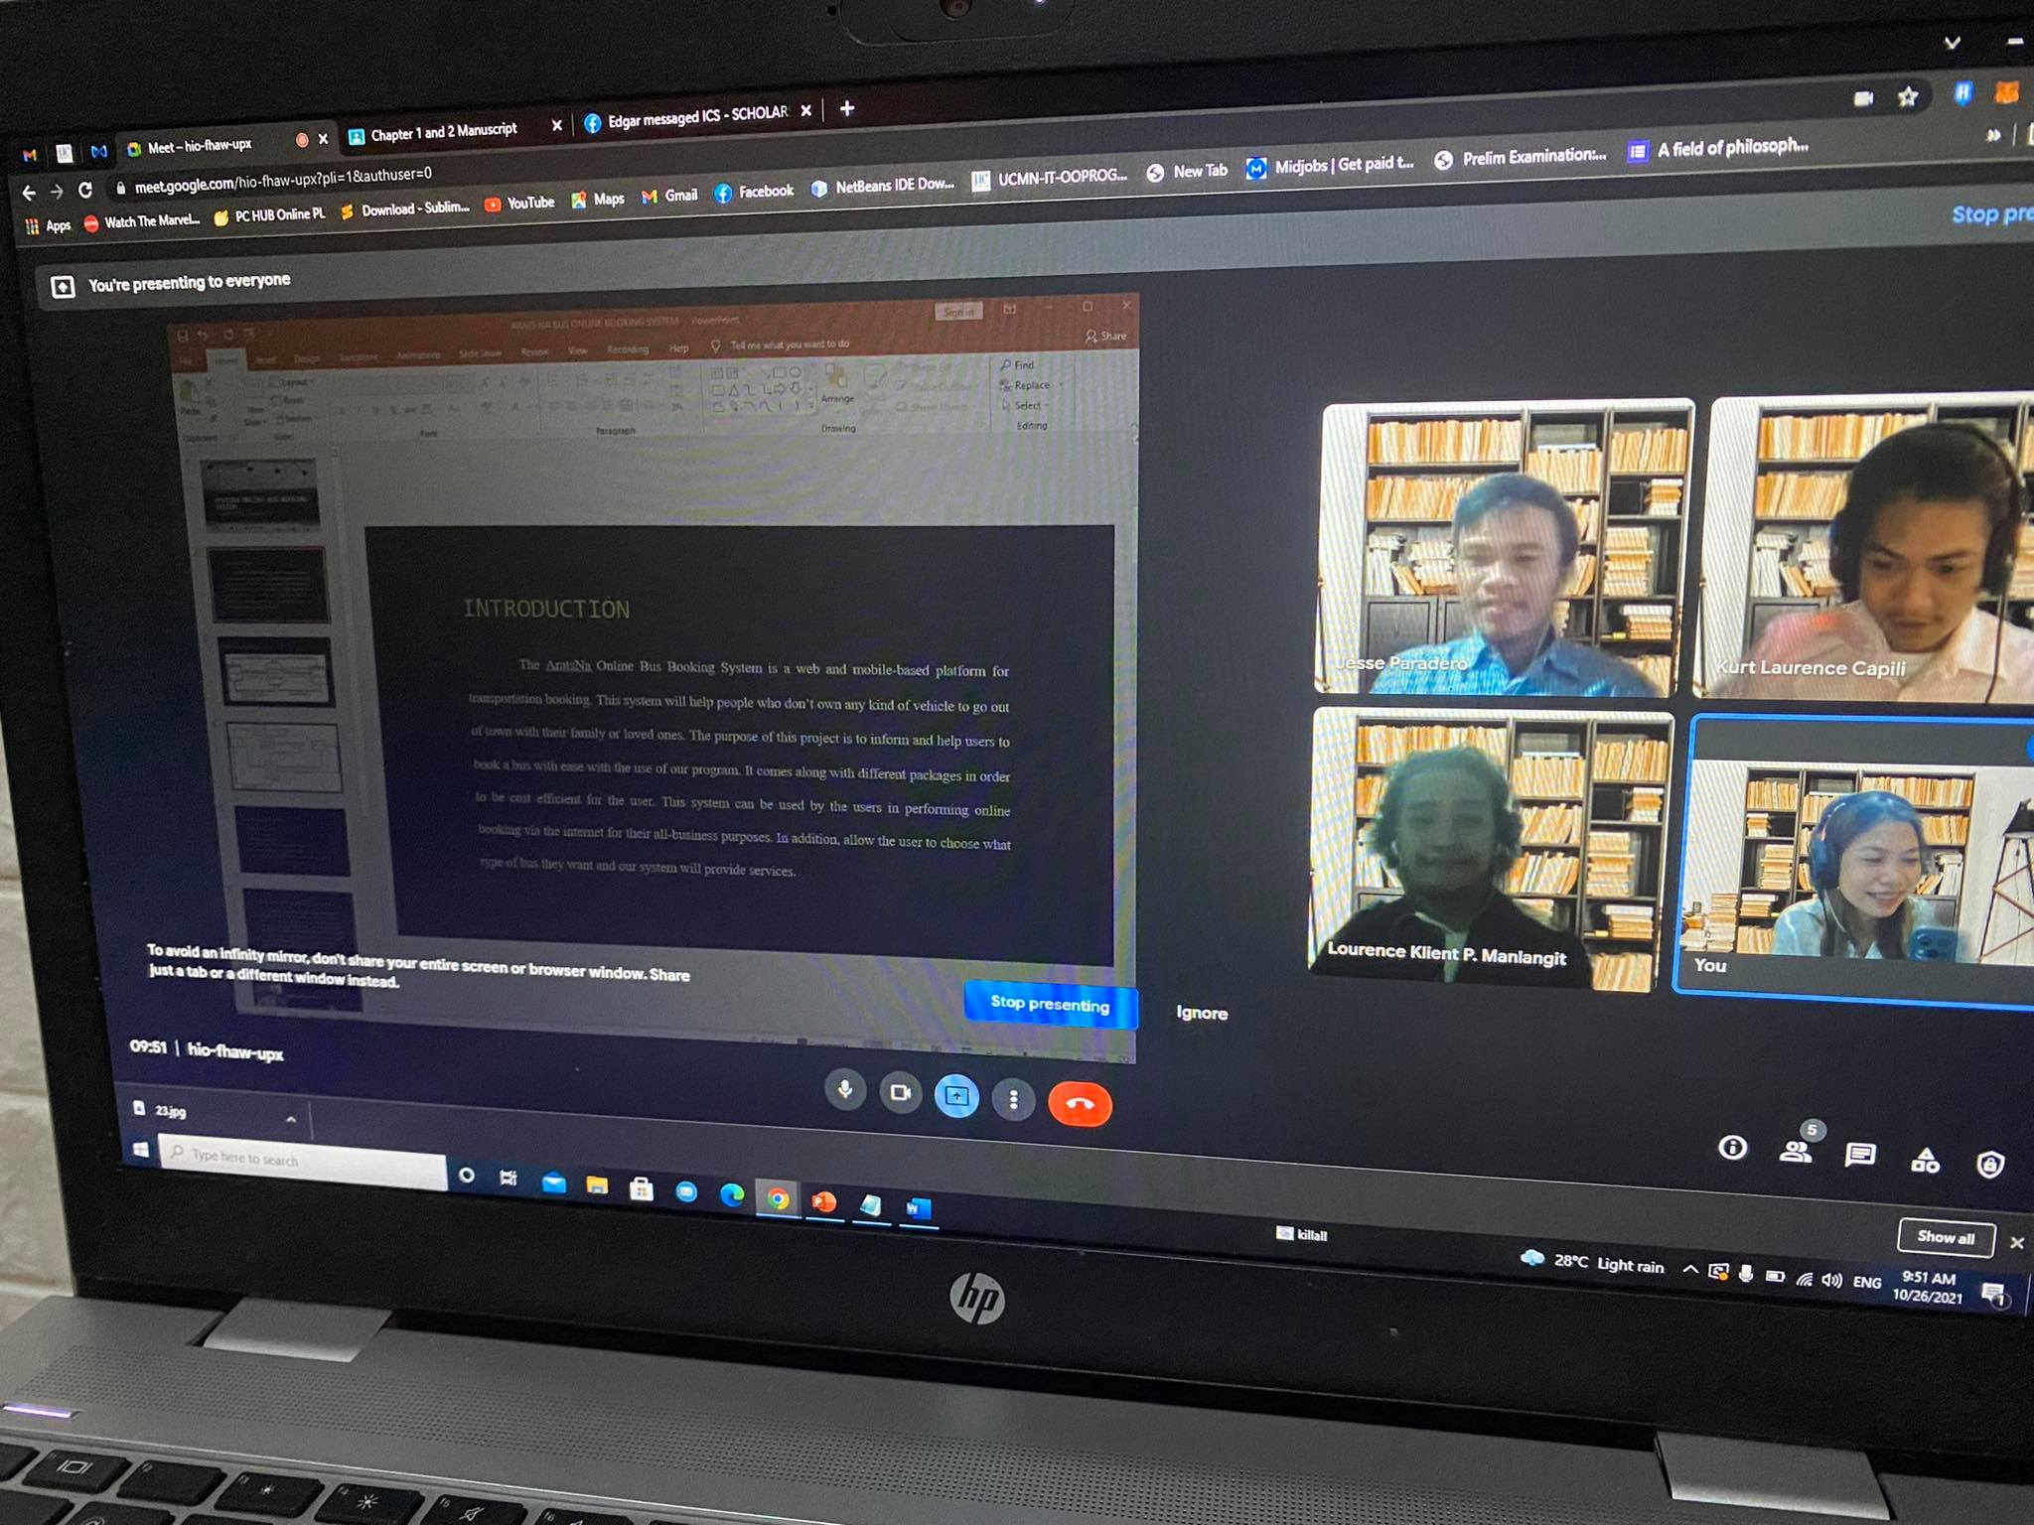
BEFORE THE DEFEND

Slide 11
PLEASE WEAR YOUR MASK AT ALL TIMES
KEEP SAFE EVERYONE ☺
THANK YOU!

